Slide 1
Genetic Algorithm Example:
Evolving a Control Program for a Virtual “Robot”

Slide 2
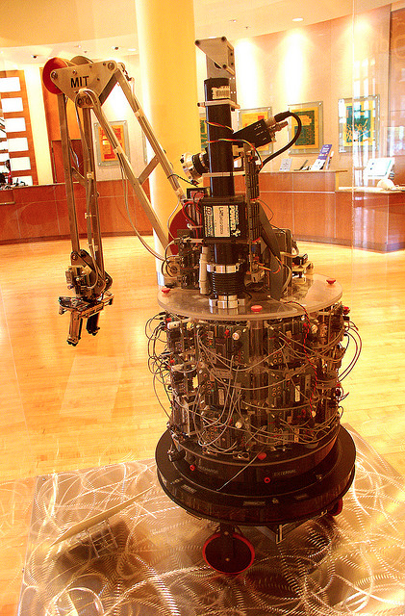
Herbert:
The Soda Can Collecting Robot
(Connell, Brooks, Ning, 1988)
http://cyberneticzoo.com/?p=5516

Slide 3
Herbert:
The Soda Can Collecting Robot
(Connell, Brooks, Ning, 1988)
Robby:
The Virtual Soda Can Collecting Robot
(Mitchell, 2009)
http://cyberneticzoo.com/?p=5516

Slide 4
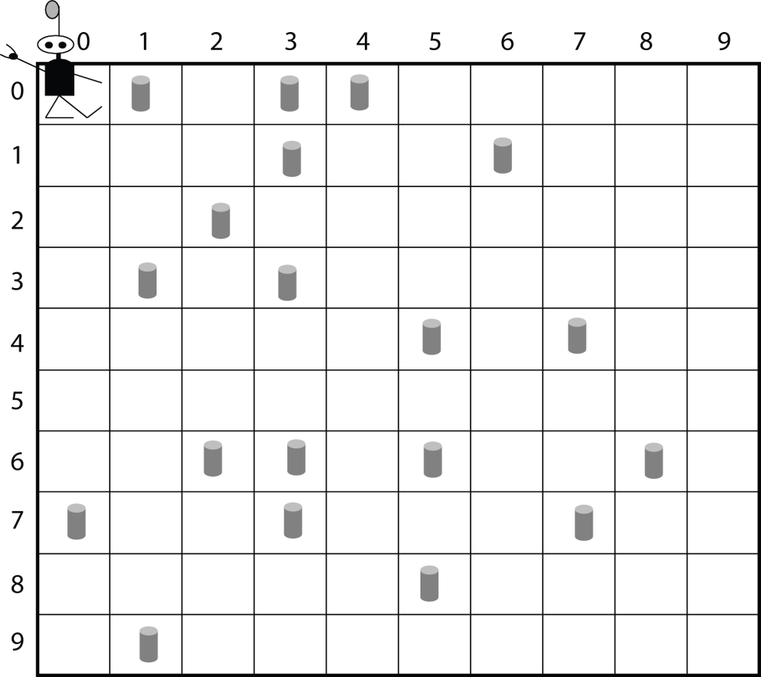
Robby’s World
Soda can

Slide 5
What Robby Can See and Do
Input:
Contents of North, South, East, West, Current
Possible actions:
Move N
Move S
Move E
Move W
Move random
Stay put
Try to pick up can
Rewards/Penalties (points):
Picks up can: 10
Tries to pick up can on empty site: -1
Crashes into wall: -5
Robby’s Score: Sum of rewards/penalties

Slide 6
Goal: Use a genetic algorithm to evolve a control program (i.e., strategy) for Robby.

Slide 7
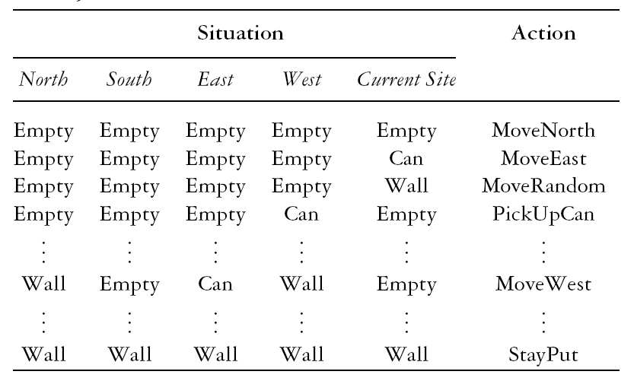
One Example Strategy
1
2
3
4
.
.
.
243

Slide 8
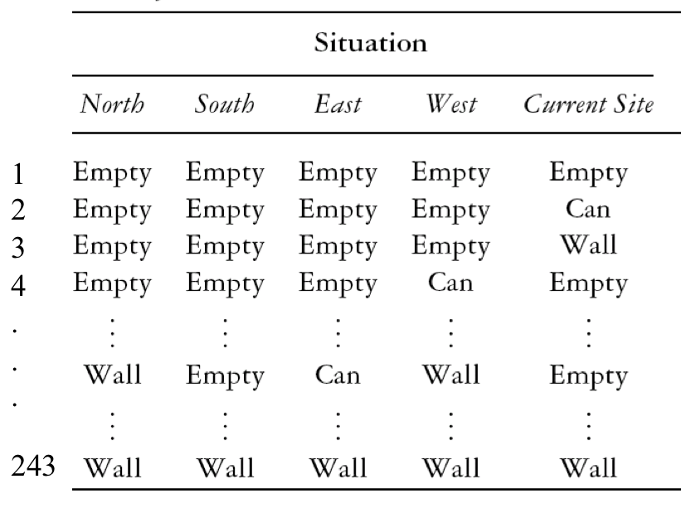
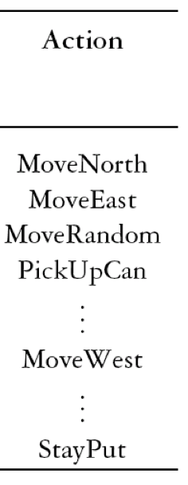
Encoding a Strategy
1
2
3
4
.
.
.
243

Slide 9
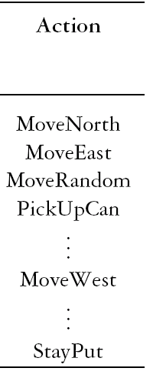
1
2
3
4
.
.
.
243

Slide 10
1
2
3
4
.
.
.
243
Code:
MoveNorth = 0
MoveSouth = 1
MoveEast = 2
MoveWest = 3
StayPut = 4
PickUpCan = 5
MoveRandom = 6

Slide 11
1
2
3
4
.
.
.
243
0 2 6 5 . . . 3 . . . 4
Code:
MoveNorth = 0
MoveSouth = 1
MoveEast = 2
MoveWest = 3
StayPut = 4
PickUpCan = 5
MoveRandom = 6

Slide 12
Question: How many possible strategies are there in our representation?
0 2 6 5 . . . 3 . . . 4

Slide 13
Question: How many possible strategies are there in our representation?
243 values
0 2 6 5 . . . 3 . . . 4
7 possible actions for each position:
7 × 7 × 7 × ... × 7

Slide 14
Question: How many possible strategies are there in our representation?
Goal: Have GA search intelligently in this vast space for a good strategy
243 values
0 2 6 5 . . . 3 . . . 4
7 possible actions for each position:
7 × 7 × 7 × ... × 7

Slide 15
Genetic algorithm for evolving strategies
Generate 200 random strategies (i.e., programs for controlling Robby)
For each strategy, calculate fitness (average reward minus penalties earned on random environments)
The strategies pair up and create offspring via crossover with random mutations ― the fitter the parents, the more offspring they create.
Keep going back to step 2 until a good-enough strategy is found (or for a set number of generations)

Slide 16
Robby’s fitness function
Calculate_Fitness (Robby) {
Total_Reward = 0 ;
Average_Reward = 0 ‘
For i = 1 to NUM_ENVIRONMENTS {
generate_random_environment( ); /* .5 probability * to place can at * each site */
For j = 1 to NUM_MOVES_PER_ENVIRONMENT {
Total_Reward = Total_Reward + perform_action(Robby);
}
}
Fitness = Total_Reward / NUM_ENVIRONMENTS;
return(Fitness);
}

Slide 17
Genetic algorithm for evolving strategies for Robby
Generate 200 random strategies (i.e., programs for controlling Robby)

Slide 18
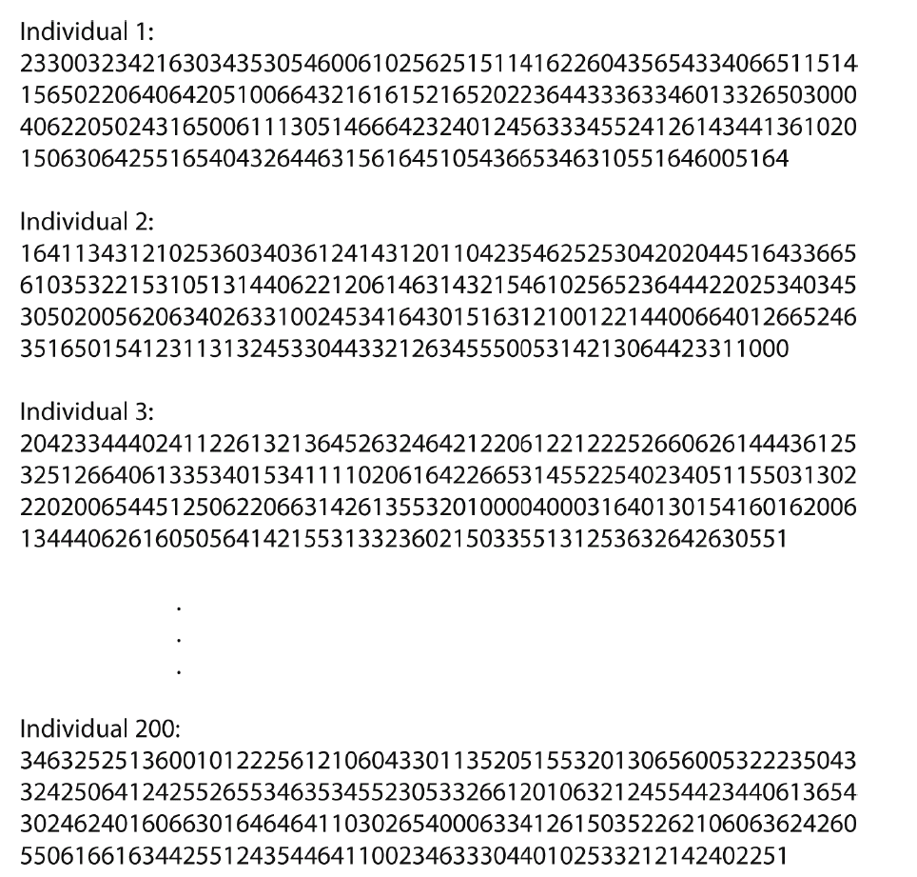
Random Initial Population

Slide 19
Genetic algorithm for evolving strategies for Robby
Generate 200 random strategies (i.e., programs for controlling Robby)
For each strategy in the population, calculate fitness (average reward minus penalties earned on random environments)

Slide 20
Fitness =
Average final score from N moves on each of M random environments

Slide 21
Genetic algorithm for evolving strategies for Robby
Generate 200 random strategies (i.e., programs for controlling Robby)
For each strategy in the population, calculate fitness (average reward minus penalties earned on random environments)
Strategies are selected according to fitness to become parents. (See code for choice of selection methods.)

Slide 22
Genetic algorithm for evolving strategies for Robby
Generate 200 random strategies (i.e., programs for controlling Robby)
For each strategy in the population, calculate fitness (average reward minus penalties earned on random environments)
Strategies are selected according to fitness to become parents. (See code for choice of selection methods.)
The parents pair up and create offspring via crossover with random mutations.

Slide 23
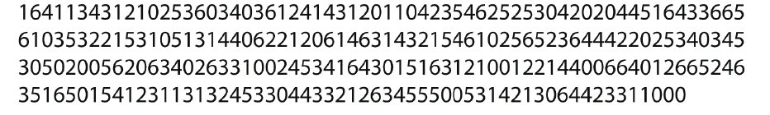
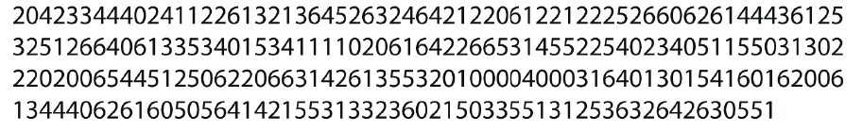
Parent 1:
Parent 2:

Slide 24
Parent 1:
Parent 2:

Slide 25
Parent 1:
Parent 2:
Child:

Slide 26
Parent 1:
Parent 2:
Mutate to “0”
Child:
Mutate to “4”

Slide 27
Genetic algorithm for evolving strategies for Robby
Generate 200 random strategies (i.e., programs for controlling Robby)
For each strategy in the population, calculate fitness (average reward minus penalties earned on random environments)
Strategies are selected according to fitness to become parents. (See code for choice of selection methods.)
The parents pair up and create offspring via crossover with random mutations.
The offspring are placed in the new population and the old population dies.

Slide 28
Genetic algorithm for evolving strategies for Robby
Generate 200 random strategies (i.e., programs for controlling Robby)
For each strategy in the population, calculate fitness (average reward minus penalties earned on random environments)
Strategies are selected according to fitness to become parents. (See code for choice of selection methods.)
The parents pair up and create offspring via crossover with random mutations.
The offspring are placed in the new population and the old population dies.
Keep going back to step 2 until a good-enough strategy is found!

Slide 29
My hand-designed strategy:
“If there is a can in the current site, pick it up.”
“Otherwise, if there is a can in one of the adjacent sites, move to that site.”
“Otherwise, choose a random direction to move in, avoiding walls.”

Slide 30
My hand-designed strategy:
“If there is a can in the current site, pick it up.”
“Otherwise, if there is a can in one of the adjacent sites, move to that site.”
“Otherwise, choose a random direction to move in, avoiding walls ”
Average fitness of this strategy: 346
(out of max possible ≈ 500)

Slide 31
My hand-designed strategy:
“If there is a can in the current site, pick it up.”
“Otherwise, if there is a can in one of the adjacent sites, move to that site.”
“Otherwise, choose a random direction to move in, avoiding walls.”
Average fitness of this strategy: 346
(out of max possible ≈ 500)
Average fitness of GA evolved strategy: 486
(out of max possible ≈ 500)

Slide 32
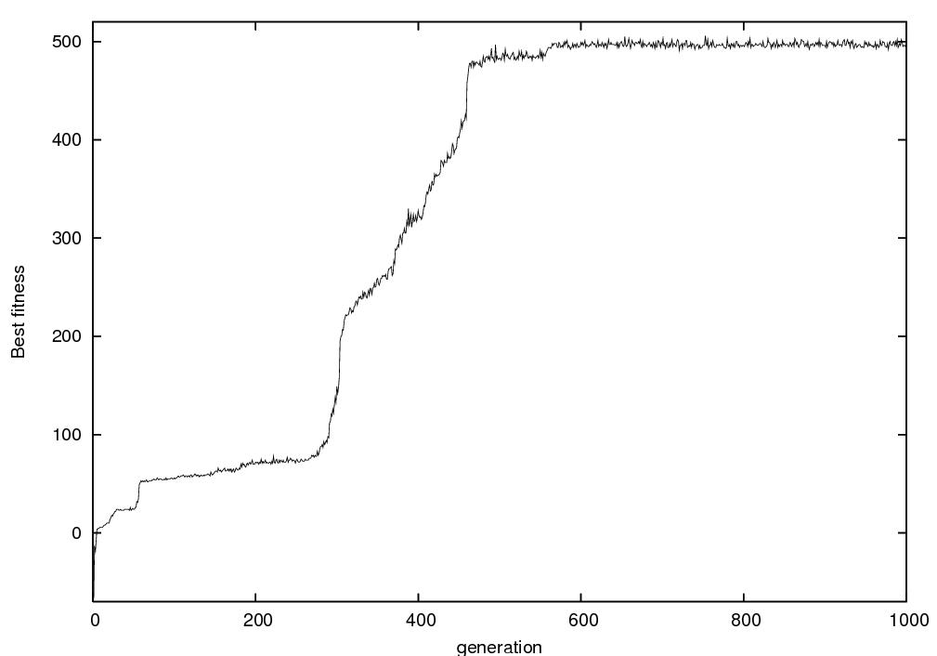
One Run of the Genetic Algorithm
Best fitness in population
Generation number

Slide 33
Generation 1
Best fitness = −81

Slide 34
Time: 0 Score: 0
0 1 2 3 4 5 6 7 8 9
0
1
2
3
4
5
6
7
8
9

Slide 35
Time: 1 Score: 0
0 1 2 3 4 5 6 7 8 9
0
1
2
3
4
5
6
7
8
9

Slide 36
Time: 2 Score: −5
0 1 2 3 4 5 6 7 8 9
0
1
2
3
4
5
6
7
8
9

Slide 37
Time: 2 Score: −5
0 1 2 3 4 5 6 7 8 9
0
1
2
3
4
5
6
7
8
9

Slide 38
Time: 3 Score: −10
0 1 2 3 4 5 6 7 8 9
0
1
2
3
4
5
6
7
8
9

Slide 39
Time: 3 Score: −10
0 1 2 3 4 5 6 7 8 9
0
1
2
3
4
5
6
7
8
9

Slide 40
Time: 4 Score: −15
0 1 2 3 4 5 6 7 8 9
0
1
2
3
4
5
6
7
8
9

Slide 41
Time: 4 Score: −15
0 1 2 3 4 5 6 7 8 9
0
1
2
3
4
5
6
7
8
9

Slide 42
Generation 14
Best fitness = 1

Slide 43
Time: 0 Score: 0
0 1 2 3 4 5 6 7 8 9
0
1
2
3
4
5
6
7
8
9

Slide 44
Time: 1 Score: 0
0 1 2 3 4 5 6 7 8 9
0
1
2
3
4
5
6
7
8
9

Slide 45
Time: 2 Score: 0
0 1 2 3 4 5 6 7 8 9
0
1
2
3
4
5
6
7
8
9

Slide 46
Time: 3 Score: 0
0 1 2 3 4 5 6 7 8 9
0
1
2
3
4
5
6
7
8
9

Slide 47
Generation 200
Fitness = 240

Slide 48
Time: 0 Score: 0
0 1 2 3 4 5 6 7 8 9
0
1
2
3
4
5
6
7
8
9

Slide 49
Time: 1 Score: 0
0 1 2 3 4 5 6 7 8 9
0
1
2
3
4
5
6
7
8
9

Slide 50
Time: 2 Score: 0
0 1 2 3 4 5 6 7 8 9
0
1
2
3
4
5
6
7
8
9

Slide 51
Time: 3 Score: 10
0 1 2 3 4 5 6 7 8 9
0
1
2
3
4
5
6
7
8
9

Slide 52
Time: 4 Score: 10
0 1 2 3 4 5 6 7 8 9
0
1
2
3
4
5
6
7
8
9

Slide 53
Time: 5 Score: 20
0 1 2 3 4 5 6 7 8 9
0
1
2
3
4
5
6
7
8
9

Slide 54
Time: 6 Score: 20
0 1 2 3 4 5 6 7 8 9
0
1
2
3
4
5
6
7
8
9

Slide 55
Time: 7 Score: 20
0 1 2 3 4 5 6 7 8 9
0
1
2
3
4
5
6
7
8
9

Slide 56
Time: 8 Score: 20
0 1 2 3 4 5 6 7 8 9
0
1
2
3
4
5
6
7
8
9

Slide 57
Time: 9 Score: 20
0 1 2 3 4 5 6 7 8 9
0
1
2
3
4
5
6
7
8
9

Slide 58
Time: 10 Score: 20
0 1 2 3 4 5 6 7 8 9
0
1
2
3
4
5
6
7
8
9

Slide 59
Time: 11 Score: 20
0 1 2 3 4 5 6 7 8 9
0
1
2
3
4
5
6
7
8
9

Slide 60
Time: 12 Score: 20
0 1 2 3 4 5 6 7 8 9
0
1
2
3
4
5
6
7
8
9

Slide 61
Time: 13 Score: 20
0 1 2 3 4 5 6 7 8 9
0
1
2
3
4
5
6
7
8
9

Slide 62
Time: 14 Score: 30
0 1 2 3 4 5 6 7 8 9
0
1
2
3
4
5
6
7
8
9

Slide 63
Time: 15 Score: 30
0 1 2 3 4 5 6 7 8 9
0
1
2
3
4
5
6
7
8
9

Slide 64
Time: 16 Score: 40
0 1 2 3 4 5 6 7 8 9
0
1
2
3
4
5
6
7
8
9

Slide 65
Time: 17 Score: 40
0 1 2 3 4 5 6 7 8 9
0
1
2
3
4
5
6
7
8
9

Slide 66
Time: 18 Score: 50
0 1 2 3 4 5 6 7 8 9
0
1
2
3
4
5
6
7
8
9

Slide 67
Time: 19 Score: 50
0 1 2 3 4 5 6 7 8 9
0
1
2
3
4
5
6
7
8
9

Slide 68
Time: 20 Score: 60
0 1 2 3 4 5 6 7 8 9
0
1
2
3
4
5
6
7
8
9

Slide 69
Generation 1000
Fitness = 492

Slide 70
Time: 0 Score: 0
0 1 2 3 4 5 6 7 8 9
0
1
2
3
4
5
6
7
8
9

Slide 71
Time: 1 Score: 0
0 1 2 3 4 5 6 7 8 9
0
1
2
3
4
5
6
7
8
9

Slide 72
Time: 2 Score: 10
0 1 2 3 4 5 6 7 8 9
0
1
2
3
4
5
6
7
8
9

Slide 73
Time: 3 Score: 10
0 1 2 3 4 5 6 7 8 9
0
1
2
3
4
5
6
7
8
9

Slide 74
Time: 4 Score: 20
0 1 2 3 4 5 6 7 8 9
0
1
2
3
4
5
6
7
8
9

Slide 75
Time: 5 Score: 20
0 1 2 3 4 5 6 7 8 9
0
1
2
3
4
5
6
7
8
9

Slide 76
Time: 6 Score: 20
0 1 2 3 4 5 6 7 8 9
0
1
2
3
4
5
6
7
8
9

Slide 77
Time: 7 Score: 20
0 1 2 3 4 5 6 7 8 9
0
1
2
3
4
5
6
7
8
9

Slide 78
Time: 8 Score: 20
0 1 2 3 4 5 6 7 8 9
0
1
2
3
4
5
6
7
8
9

Slide 79
Time: 9 Score: 30
0 1 2 3 4 5 6 7 8 9
0
1
2
3
4
5
6
7
8
9

Slide 80
Time: 10 Score: 30
0 1 2 3 4 5 6 7 8 9
0
1
2
3
4
5
6
7
8
9

Slide 81
Time: 11 Score: 40
0 1 2 3 4 5 6 7 8 9
0
1
2
3
4
5
6
7
8
9

Slide 82
Time: 12 Score: 40
0 1 2 3 4 5 6 7 8 9
0
1
2
3
4
5
6
7
8
9

Slide 83
Time: 13 Score: 50
0 1 2 3 4 5 6 7 8 9
0
1
2
3
4
5
6
7
8
9

Slide 84
Time: 14 Score: 50
0 1 2 3 4 5 6 7 8 9
0
1
2
3
4
5
6
7
8
9

Slide 85
Time: 15 Score: 60
0 1 2 3 4 5 6 7 8 9
0
1
2
3
4
5
6
7
8
9

Slide 86
Time: 16 Score: 60
0 1 2 3 4 5 6 7 8 9
0
1
2
3
4
5
6
7
8
9

Slide 87
Time: 17 Score: 70
0 1 2 3 4 5 6 7 8 9
0
1
2
3
4
5
6
7
8
9

Slide 88
Time: 18 Score: 70
0 1 2 3 4 5 6 7 8 9
0
1
2
3
4
5
6
7
8
9

Slide 89
Why Did The GA’s Strategy Outperform Mine?

Slide 90
My Strategy

Slide 91
0 1 2 3 4 5 6 7 8 9
0
1
2
3
4
5
6
7
8
9

Slide 92
0 1 2 3 4 5 6 7 8 9
0
1
2
3
4
5
6
7
8
9

Slide 93
0 1 2 3 4 5 6 7 8 9
0
1
2
3
4
5
6
7
8
9

Slide 94
0 1 2 3 4 5 6 7 8 9
0
1
2
3
4
5
6
7
8
9

Slide 95
0 1 2 3 4 5 6 7 8 9
0
1
2
3
4
5
6
7
8
9

Slide 96
The GA’s Evolved Strategy

Slide 97
0 1 2 3 4 5 6 7 8 9
0
1
2
3
4
5
6
7
8
9

Slide 98
0 1 2 3 4 5 6 7 8 9
0
1
2
3
4
5
6
7
8
9

Slide 99
0 1 2 3 4 5 6 7 8 9
0
1
2
3
4
5
6
7
8
9

Slide 100
0 1 2 3 4 5 6 7 8 9
0
1
2
3
4
5
6
7
8
9

Slide 101
0 1 2 3 4 5 6 7 8 9
0
1
2
3
4
5
6
7
8
9

Slide 102
0 1 2 3 4 5 6 7 8 9
0
1
2
3
4
5
6
7
8
9

Slide 103
0 1 2 3 4 5 6 7 8 9
0
1
2
3
4
5
6
7
8
9

Slide 104
0 1 2 3 4 5 6 7 8 9
0
1
2
3
4
5
6
7
8
9

Slide 105
0 1 2 3 4 5 6 7 8 9
0
1
2
3
4
5
6
7
8
9

Slide 106
0 1 2 3 4 5 6 7 8 9
0
1
2
3
4
5
6
7
8
9

Slide 107
0 1 2 3 4 5 6 7 8 9
0
1
2
3
4
5
6
7
8
9

